Slide 1
Apache Flume

Slide 2
Why Flume
Situation
You have hundreds of services running in different servers that produce lots of large logs which should be analyzed altogether. You have Hadoop to process them.
Problem
How to send all the logs to a place that has Hadoop? Ineed a reliable, scalable, extensible and manageable way to do it!

Slide 3
Apache Flume
It is a distributed data collection service that gets flows of data (like logs) from their source and aggregates them to where they have to be processed.
Goals: reliability, scalability, extensibility,
manageability.

Slide 4
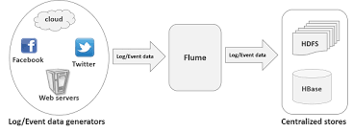
Flume - Usecase

Slide 5
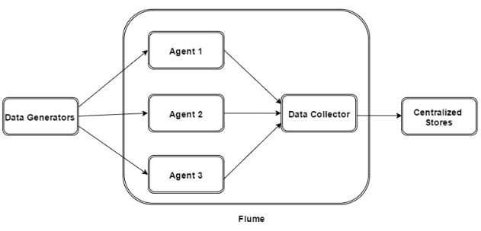
Flume Architecture

Slide 6
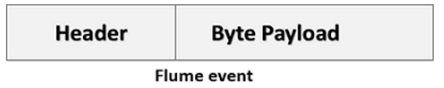
Flume Event
An event is the basic unit of the data transported inside Flume.
It contains a payload of byte array that is to be transported from the source to the destination accompanied by optional headers.

Slide 7
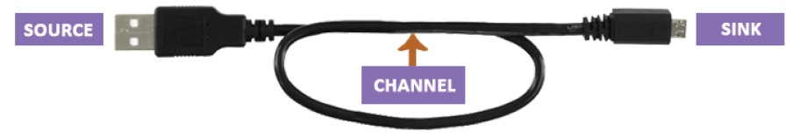
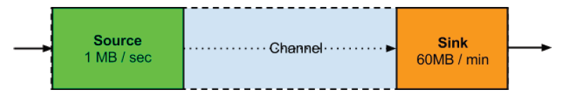
The Flume Agent Model

Slide 8
Flume Agent
An agent is an independent daemon process (JVM) in Flume.
It receives the data (events) from clients or other agents and forwards it to its next destination (sink or agent).
Flume may have more than one agent.
Flume Agent contains three main components namely, source, channel, and sink.

Slide 9
Component of Flume - Source
Receives data from the data generators and transfers it to one or more channels in the form of Flume events.
Apache Flume supports several types of sources and each source receives events from a specified data generator.
Example − Avro source, Thrift source, twitter source etc.

Slide 10
Component of Flume - Channels
A channel is a transient store which receives the events from the source and buffers them till they are consumed by sinks.
It acts as a bridge between the sources and the sinks.
These channels are fully transactional and they can work with any number of sources and sinks.
Example − JDBC channel, File system channel, Memory channel, etc.

Slide 11
Component of Flume - Sink
A sink stores the data into centralized stores like HBase and HDFS.
It consumes the data (events) from the channels and delivers it to the destination.
The destination of the sink might be another agent or the central stores.
Example − HDFS sink

Slide 12
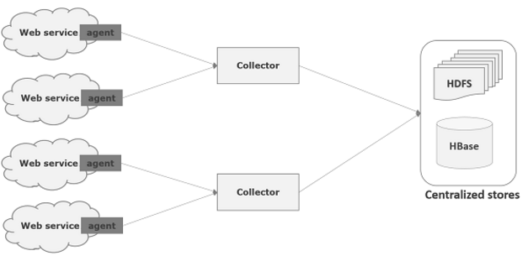
Apache Flume- Data Flow

Slide 13
Apache Flume- Data Flow
Multi-hop Flow
Within Flume, there can be multiple agents and before reaching the final destination, an event may travel through more than one agent. This is known as multi-hop flow.

Slide 14
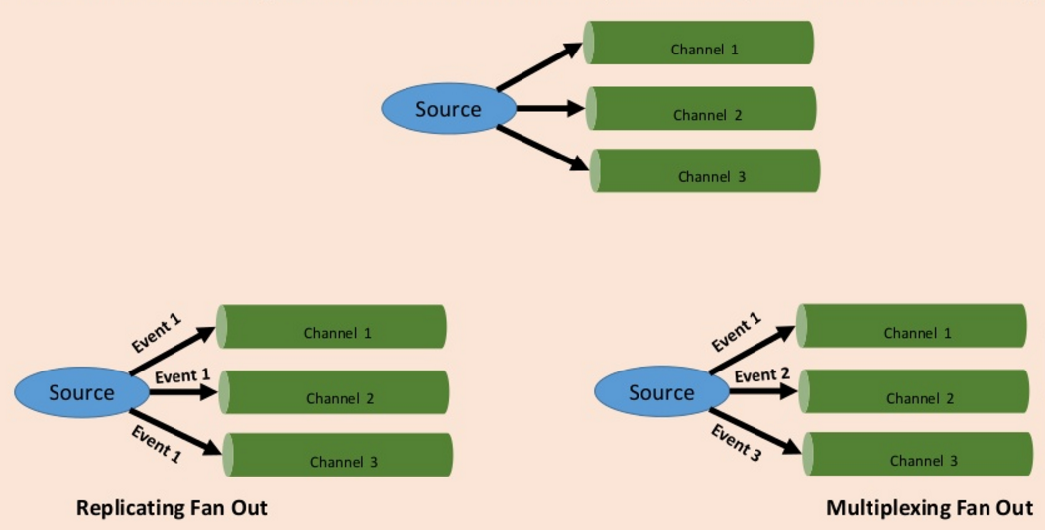
Apache Flume- Data Flow
Fan-Out

Slide 15
Apache Flume- Data Flow
Fan-in Flow
The data flow in which the data will be transferred from many sources to one channel is known as fan-in flow.

Slide 16
Apache Flume- Configuration
In the Flume configuration file, we need to
Name the components of the current agent.
Describe/Configure the source.
Describe/Configure the sink.
Describe/Configure the channel.
Bind the source and the sink to the channel.

Slide 17
Name the components
List the components such as sources, sinks, and the channels of the agent
Syntax:
agent_name.sources = source_name
agent_name.sinks = sink_name
agent_name.channels = channel_name
Example:
TwitterAgent.sources = Twitter
TwitterAgent.channels = MemChannel
TwitterAgent.sinks = HDFS
ClickTo know more about supported components

Slide 18
Configure the source
Syntax:
agent_name.sources. source_name.type = value
agent_name.sources. source_name.property2 = value
agent_name.sources. source_name.property3 = value
Example:
TwitterAgent.sources.Twitter.type = Twitter (type name)
TwitterAgent.sources.Twitter.consumerKey =
TwitterAgent.sources.Twitter.consumerSecret =
TwitterAgent.sources.Twitter.accessToken =
TwitterAgent.sources.Twitter.accessTokenSecret =

Slide 19
Configure the Sink
Syntax:
agent_name.sinks. sink_name.type = value
agent_name.sinks. sink_name.property2 = value
agent_name.sinks. sink_name.property3 = value
Example:
TwitterAgent.sinks.HDFS.type = hdfs (type name)
TwitterAgent.sinks.HDFS.hdfs.path = HDFS directory’s Path to store the data

Slide 20
Configure the Channel
Syntax:
agent_name.channels.channel_name.type = value
agent_name.channels.channel_name. property2 = value
agent_name.channels.channel_name. property3 = value
Example:
TwitterAgent.channels.MemChannel.type = memory (type name)

Slide 21
Binding the Source and the Sink to the Channel
Syntax:
agent_name.sources.source_name.channels = channel_name
agent_name.sinks.sink_name.channels = channel_name
Example:
TwitterAgent.sources.Twitter.channels = MemChannel
TwitterAgent.sinks.HDFS.channels = MemChannel

Slide 22
Starting Flume Agent
$ bin/flume-ng agent --conf ./conf/ -f conf/twitter.conf Dflume.root.logger=DEBUG,console -n TwitterAgent
Where
agent − Command to start the Flume agent
--conf ,-c<conf> − Use configuration file in the conf directory
-f<file> − Specifies a config file path, if missing
--name, -n <name> − Name of the twitter agent
-D property =value − Sets a Java system property value.

Slide 23

Thank You
World Headquarters
3270 West Big Beaver Road
Troy, MI 48084, U.S.A
Phone : 248.786.2500
Fax : 248.786.2515
Web : www.htcinc.com
Global Delivery Center
SDF II, Phase II, MEPZ
Tambaram, Chennai - 600 045
India
Phone : +91 44 2262 3522
Fax : +91 44 2262 7713

